Slide 1
Entity-oriented Filtering of Large Streams TREC KBA 2012-2014 Knowledge Base Acceleration
John R. Frank jrf@mit.edu | Dan A. Roberts drob@mit.edu |  | Max Kleiman-Weiner maxkw@mit.edu
Ellen Voorhees ellen.voorhees@nist.gov |  | Ian Soboroff ian.soboroff@nist.gov
http://trec-kba.org

Slide 2
How many days must a news article wait before being cited in Wikipedia?
Notes:
This shows the lag time between publication and eventual citation of news articles linked from pages in Category:Living_people.
The median lag time for articles published after 2001 is more than 1.5 years.
You can see the lag time leveling out to a long heavy tail for earlier articles, and then only gradually accelerating for a small handful of news articles that get incorporated rapidly – out of ~50,000 articles only ~300 had a lag time of less than a day.

Slide 3
Accelerate?
rate of assimilation << stream size
# editors << # entities << # mentions
(definition of a “large” KB)

Slide 4
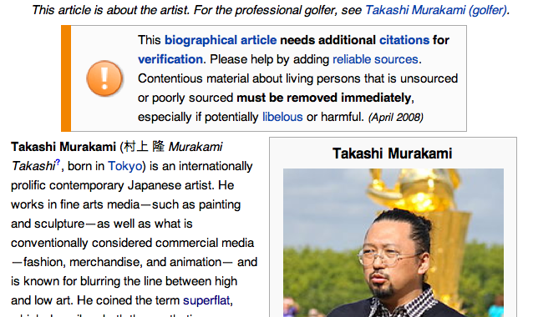
TREC KBA 2014 Stream Filtering to Recommend Citations and Fill Slots
Entities in Wikipedia or another Knowledge Base
Initialize with target entities
Start with citations before dateX (20%)
Iterate over stream of text items
Predict citations after dateX (80%)
Citation = “vital”, i.e. changes profile
Identify infobox slot values
Automatically recommend new edits
Content Stream
1.2bn texts, 50% English
>500M tagged by Serif
13,663 hours of data (19 months)
10⁵ docs-per-hour
News, blogs, forums, preprints, and more
Your KBA System

Slide 5
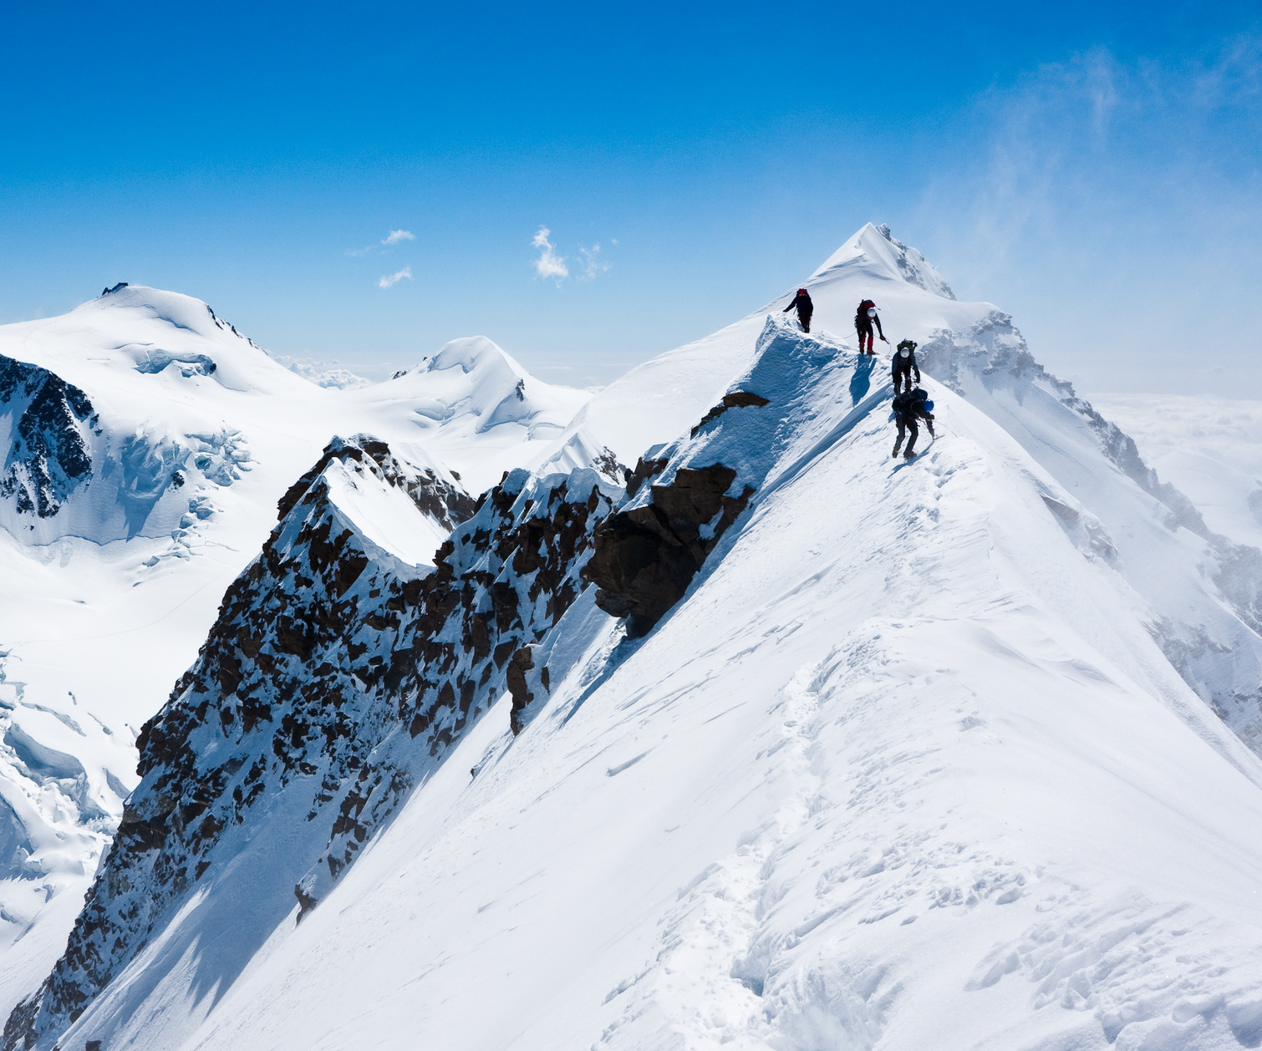
TRECing the continental divide between NLU and IR
Natural Language Understanding:
Data parsing centric
Universal annotation
Scores → probabilities
Reductionist
Information Retrieval:
User task centric
Variation in interpretation
Scores → cascading lists
Constructionist, emergence

Slide 6
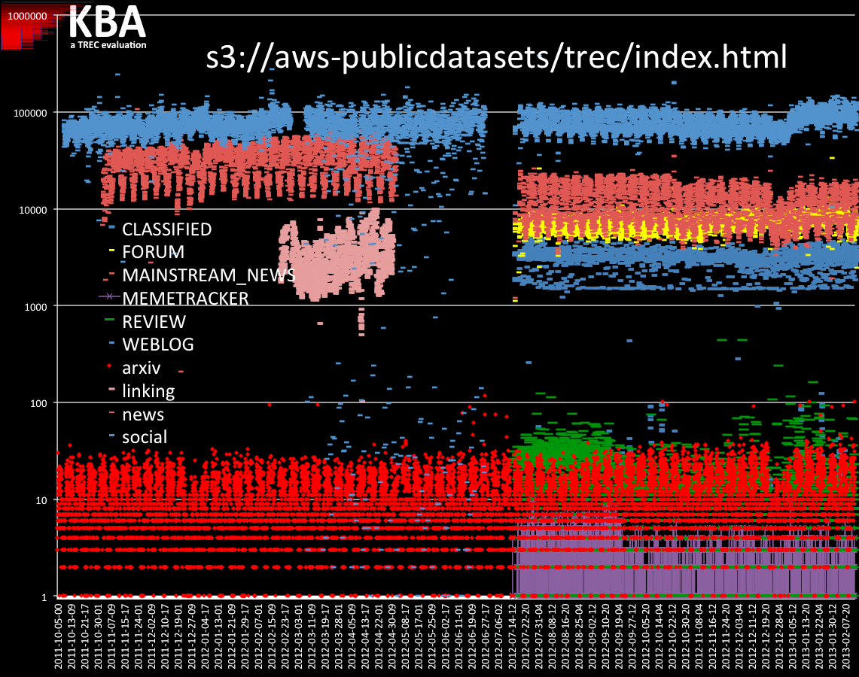

Slide 7
1,187,974,321 documents total
579,838,246 English docs tagged by BBN Serif
NER, within-doc coref
Sentence Parse Trees
Relations

Slide 8
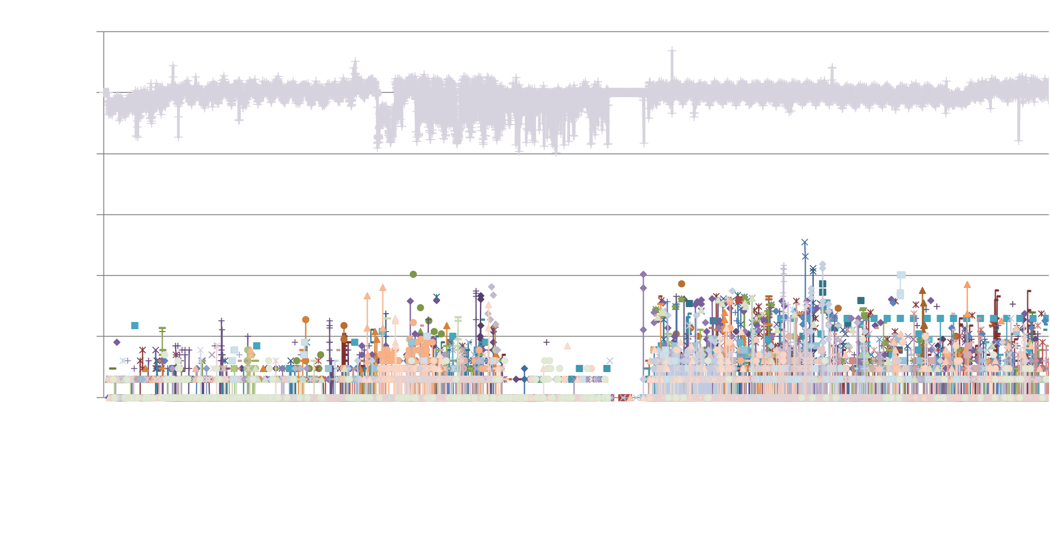
training
evaluation
Corpus counts per hour
Pre-hoc assess all surface mentions
“vital” docs change entity profile → filling a slot?

Slide 9
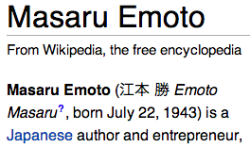
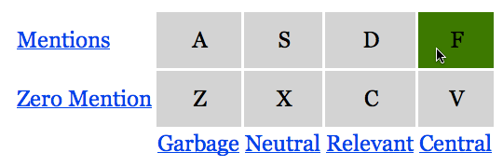
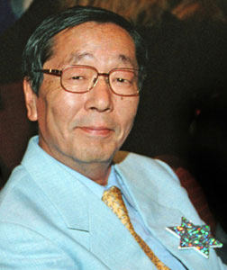
Refine “central” → “vital”
2012
Published: March 31, 2012
Impact of Thoughts on Water
By Denis Gorce-Bourge
Water covers 70% of our Blue planet and our body is made of about 70% water.
Masaru Emoto is a Japanese Photographer and scientist. He is known over the world for his remarkable work on water and its deep connection with individual and collective consciousness.
For decades, Masaru took pictures of frozen crystals of water and tested the direct influence of the environment on the quality of those crystals.
Pollution has a direct impact on the beauty of a frozen crystal but as well words, music and thoughts. He tested the quality of water crystals by exposing it to various conditions: to written words like hate and violence and Love and gratitude. The results were just astonishing. The crystal exposed to Love and gratitude was beautiful and perfectly formed where the other one was severely degraded. He demonstrated as well the impact of Heavy Metal music versus Mozart or Beethoven and how the vibration of music impacts water.
The very shape of water crystals is modified by violence, aggression, and negative words.

Slide 10
Refine “central” → “vital”
2013
F
D
Garbage Neutral Useful Vital
Published: March 31, 2012
Impact of Thoughts on Water
By Denis Gorce-Bourge
Water covers 70% of our Blue planet and our body is made of about 70% water.
Masaru Emoto is a Japanese Photographer and scientist. He is known over the world for his remarkable work on water and its deep connection with individual and collective consciousness.
For decades, Masaru took pictures of frozen crystals of water and tested the direct influence of the environment on the quality of those crystals.
Pollution has a direct impact on the beauty of a frozen crystal but as well words, music and thoughts. He tested the quality of water crystals by exposing it to various conditions: to written words like hate and violence and Love and gratitude. The results were just astonishing. The crystal exposed to Love and gratitude was beautiful and perfectly formed where the other one was severely degraded. He demonstrated as well the impact of Heavy Metal music versus Mozart or Beethoven and how the vibration of music impacts water.
The very shape of water crystals is modified by violence, aggression, and negative words.

Slide 11
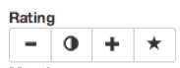
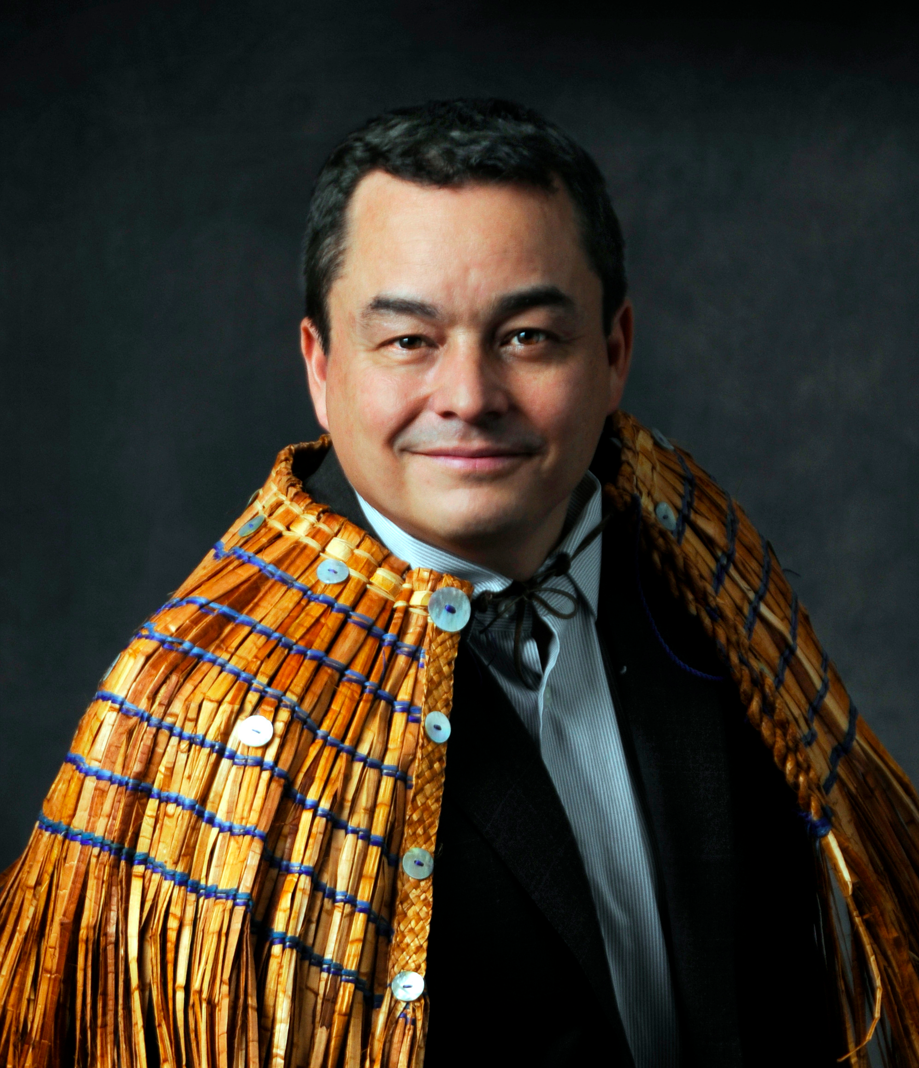
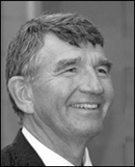
Vital = Timely
Wrong Unk. Useful Vital
The National Chief of the Assembly of First Nations Shawn Atleo is on his way to Inuvik, N.W.T., this afternoon, after attending an event in Yellowknife this morning.
Here’s what State Superintendent Randy Dorn had to say about Gregoire’s plans…

Slide 12
Vital = Timely
Wrong Unk. Useful Vital
Queries (entities)
27 people
2 organizations
all from Wikipedia
98 people, 19 organizations, and 24 facilities. Fourteen inter-related communities of entities, such small towns like Danville, KY, and Fargo, ND, and academic communities like Turing award winners.
86 people, 16 organizations, and 7 facilities all from the geographic region between Seattle and Vancouver.
Subjective disagreements amongst assessors primarily from:
What is interesting enough to record in KB.
Time window of novelty; how long is info “new”?

Slide 13
2012
string matching
task generator
91% recall
15% precision
26% F₁

Slide 14
2013

Slide 15
2014

Slide 16
max F_1 (macroP, macroR)
2013
vital

Slide 17
max F_1 (macroP, macroR)
2013
vital
Vital + Useful

Slide 18
max F_1 (macroP, macroR)
2014
vital

Slide 19
max F_1 (macroP, macroR)
2014
vital
Vital + Useful

Slide 20
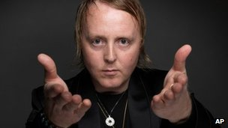
SSF example:
“FounderOf” slot on James McCartney
BBC: “What would you say to forming The Beatles - The Next Generation” …
James: “… I'd be up for it.”
echo
Confidence of sensitive versus insensitive systems

Slide 21
SSF Truth Record
{
"http://en.wikipedia.org/wiki/Geoffrey_E._Hinton": {
"AwardsWon": {
"equiv_id_638": {
"stream_ids": [
"1333632971-708c60ffdf54064e32eafeffbe145a51",
"1333423260-5a728deb9b81ba22a0109ad767ba4457",
"1353337781-efc6c892f4f07f33573451d818e8629c"
],
"aliases": [
"2012 Killam Prize in engineering",
"Killam Prize",
"2012 Canada Council's Killam Prize laureates",
"2012 Killam Prize"
],
"begin": "2012-04-03-03",
"end": "2012-11-19-15",
"beginState": "|",
"endState": ">”
},

Slide 22
DOCS-level
DOCS
{
"http://en.wikipedia.org/wiki/Geoffrey_E._Hinton": {
"AwardsWon": {
"equiv_id_638": {
"stream_ids": [
"1333632971-708c60ffdf54064e32eafeffbe145a51",
"1333423260-5a728deb9b81ba22a0109ad767ba4457",
"1353337781-efc6c892f4f07f33573451d818e8629c"
],
"aliases": [
"2012 Killam Prize in engineering",
"Killam Prize",
"2012 Canada Council's Killam Prize laureates",
"2012 Killam Prize"
],
"begin": "2012-04-03-03",
"end": "2012-11-19-15",
"beginState": "|",
"endState": ">”
},
{
"http://en.wikipedia.org/wiki/Geoffrey_E._Hinton": {
"AwardsWon": {
"equiv_id_638": {
"stream_ids": [
"1333632971-708c60ffdf54064e32eafeffbe145a51",
"1333423260-5a728deb9b81ba22a0109ad767ba4457",
"1353337781-efc6c892f4f07f33573451d818e8629c"
],
"begin": "2012-04-03-03",
"end": "2012-11-19-15",
"beginState": "|",
"endState": ">",
"aliases": [
"2012 Killam Prize in engineering",
"Killam Prize",
"2012 Canada Council's Killam Prize laureates",
"2012 Killam Prize"
]
},
{
"http://en.wikipedia.org/wiki/Geoffrey_E._Hinton": {
"AwardsWon": {
"equiv_id_638": {
"stream_ids": [
"1333632971-708c60ffdf54064e32eafeffbe145a51",
"1333423260-5a728deb9b81ba22a0109ad767ba4457",
"1353337781-efc6c892f4f07f33573451d818e8629c"
],
"begin": "2012-04-03-03",
"end": "2012-11-19-15",
"beginState": "|",
"endState": ">",
"aliases": [
"2012 Killam Prize in engineering",
"Killam Prize",
"2012 Canada Council's Killam Prize laureates",
"2012 Killam Prize"
]
},
{
"http://en.wikipedia.org/wiki/Geoffrey_E._Hinton": {
"AwardsWon": {
"equiv_id_638": {
"stream_ids": [
"1333632971-708c60ffdf54064e32eafeffbe145a51",
"1333423260-5a728deb9b81ba22a0109ad767ba4457",
"1353337781-efc6c892f4f07f33573451d818e8629c"
],
"begin": "2012-04-03-03",
"end": "2012-11-19-15",
"beginState": "|",
"endState": ">",
"aliases": [
"2012 Killam Prize in engineering",
"Killam Prize",
"2012 Canada Council's Killam Prize laureates",
"2012 Killam Prize"
]
},

Slide 23
OVERLAPS-level
DOCS
OVERLAPS
{
"http://en.wikipedia.org/wiki/Geoffrey_E._Hinton": {
"AwardsWon": {
"equiv_id_638": {
"stream_ids": [
"1333632971-708c60ffdf54064e32eafeffbe145a51",
"1333423260-5a728deb9b81ba22a0109ad767ba4457",
"1353337781-efc6c892f4f07f33573451d818e8629c"
],
"aliases": [
"2012 Killam Prize in engineering",
"Killam Prize",
"2012 Canada Council's Killam Prize laureates",
"2012 Killam Prize"
],
"begin": "2012-04-03-03",
"end": "2012-11-19-15",
"beginState": "|",
"endState": ">”
},

Slide 24
FILLS-level (coref)
DOCS
OVERLAPS
{
"http://en.wikipedia.org/wiki/Geoffrey_E._Hinton": {
"AwardsWon": {
"equiv_id_638": {
"stream_ids": [
"1333632971-708c60ffdf54064e32eafeffbe145a51",
"1333423260-5a728deb9b81ba22a0109ad767ba4457",
"1353337781-efc6c892f4f07f33573451d818e8629c"
],
"aliases": [
"2012 Killam Prize in engineering",
"Killam Prize",
"2012 Canada Council's Killam Prize laureates",
"2012 Killam Prize"
],
"begin": "2012-04-03-03",
"end": "2012-11-19-15",
"beginState": "|",
"endState": ">”
},
FILLS (coref)

Slide 25
DATE_HOUR-level
DOCS
OVERLAPS
DATE_HOUR
{
"http://en.wikipedia.org/wiki/Geoffrey_E._Hinton": {
"AwardsWon": {
"equiv_id_638": {
"stream_ids": [
"1333632971-708c60ffdf54064e32eafeffbe145a51",
"1333423260-5a728deb9b81ba22a0109ad767ba4457",
"1353337781-efc6c892f4f07f33573451d818e8629c"
],
"aliases": [
"2012 Killam Prize in engineering",
"Killam Prize",
"2012 Canada Council's Killam Prize laureates",
"2012 Killam Prize"
],
"begin": "2012-04-03-03",
"end": "2012-11-19-15",
"beginState": "|",
"endState": ">”
},
FILLS (coref)

Slide 26
Overly complex four-stage scoring 2013
1) DOCS
2) OVERLAPS
4) DATE_HOUR
{
"http://en.wikipedia.org/wiki/Geoffrey_E._Hinton": {
"AwardsWon": {
"equiv_id_638": {
"stream_ids": [
"1333632971-708c60ffdf54064e32eafeffbe145a51",
"1333423260-5a728deb9b81ba22a0109ad767ba4457",
"1353337781-efc6c892f4f07f33573451d818e8629c"
],
"aliases": [
"2012 Killam Prize in engineering",
"Killam Prize",
"2012 Canada Council's Killam Prize laureates",
"2012 Killam Prize"
],
"begin": "2012-04-03-03",
"end": "2012-11-19-15",
"beginState": "|",
"endState": ">”
},
3) FILLS (coref)

Slide 27
 | unnormalized |  |  | normalized
uses occurrence counts | team_system | dot product |  | team_system | cosine
 | baseline-ssf | 5107 |  | BUPT_PRIS-ssf2 | 61.12
 | baseline-ssf_oracle | 4724 |  | SCU-ssf_9 | 54.56
 | ecnu-ssf_run | 1061 |  | SCU-ssf_12 | 54.56
 | BUPT_PRIS-ssf2 | 782 |  | SCU-ssf_8 | 54.56
 | BUPT_PRIS-ssf1 | 601 |  | SCU-ssf_7 | 54.56
 | SCU-ssf_6 | 423 |  | SCU-ssf_14 | 54.56
 | SCU-ssf_11 | 423 |  | SCU-ssf_13 | 54.56
 | SCU-ssf_2 | 423 |  | SCU-ssf_3 | 52.61
 | SCU-ssf_1 | 422 |  | SCU-ssf_10 | 52.61
 | SCU-ssf_3 | 421 |  | SCU-ssf_5 | 52.61
 | SCU-ssf_10 | 421 |  | SCU-ssf_6 | 49.89
 | SCU-ssf_5 | 421 |  | SCU-ssf_11 | 49.89
 | SCU-ssf_9 | 247 |  | SCU-ssf_2 | 49.89
 | SCU-ssf_12 | 247 |  | SCU-ssf_1 | 44.59
 | SCU-ssf_8 | 247 |  | ecnu-ssf_run | 42.68
 | SCU-ssf_7 | 247 |  | BUPT_PRIS-ssf1 | 41.72
 | SCU-ssf_14 | 247 |  | SCU-ssf_4 | 37.03
 | SCU-ssf_13 | 247 |  | baseline-ssf | 29.06
 | SCU-ssf_4 | 127 |  | baseline-ssf_oracle | 26.71
ignores occurrence counts | team_system | c_TT |  | team_system | sokalsneath
 | baseline-ssf | 3560 |  | baseline-ssf | 310.22
 | baseline-ssf_oracle | 3227 |  | baseline-ssf_oracle | 281.14
 | ecnu-ssf_run | 483 |  | BUPT_PRIS-ssf2 | 91.51
 | BUPT_PRIS-ssf2 | 481 |  | BUPT_PRIS-ssf1 | 90.32
 | BUPT_PRIS-ssf1 | 380 |  | ecnu-ssf_run | 55.45
 | SCU-ssf_6 | 269 |  | SCU-ssf_6 | 36.58
 | SCU-ssf_11 | 269 |  | SCU-ssf_11 | 36.58
 | SCU-ssf_2 | 269 |  | SCU-ssf_2 | 36.58
 | SCU-ssf_3 | 267 |  | SCU-ssf_3 | 36.10
 | SCU-ssf_10 | 267 |  | SCU-ssf_10 | 36.10
 | SCU-ssf_5 | 267 |  | SCU-ssf_5 | 36.10
 | SCU-ssf_1 | 262 |  | SCU-ssf_1 | 35.79
 | SCU-ssf_9 | 129 |  | SCU-ssf_9 | 26.95
 | SCU-ssf_12 | 129 |  | SCU-ssf_12 | 26.95
 | SCU-ssf_8 | 129 |  | SCU-ssf_8 | 26.95
 | SCU-ssf_7 | 129 |  | SCU-ssf_7 | 26.95
 | SCU-ssf_14 | 129 |  | SCU-ssf_14 | 26.95
 | SCU-ssf_13 | 129 |  | SCU-ssf_13 | 26.95
 | SCU-ssf_4 | 64 |  | SCU-ssf_4 | 18.64
Simplified Scoring
SSF 2014

Slide 28
Lessons Learned … so far
Slots → subtopics
NLU algorithms using rigid ontologies provide great signals
Only half of vital docs changed a ontologized slot
Consider: “M.I.A.,” a rapper, who tweeted that her daughter’s father is using New York’s child custody laws to perpetrate a human rights violation.
KBA StreamCorpus
Salient events for noteworthy people in public stream
Skims surface of networks of entities in narrower domains
Entity profiles evolve over time and study
Exploring these issues in new track: TREC Dynamic Domain

Slide 29
Fantastic Participants
2012 | 2013 | 2014
Centrum Wiskunde & Informatica (CWI) HLT COE IGPI LSIS Pattern Recognition and Intelligent System (PRIS) SCIA U. of Amsterdam (UvA) U. Delaware (UDel) U. Helsinki U. Illinois, Urbana-Champaign (UIUC) UMass Amherst | Beijing Institute of Tech (BIT) CWI Institut de Recherche en Inform. de Toulouse (IRIT) LSIS/LIA: PRIS Santa Clara University (SCU) Stanford University UvA UDel U. of Florida UIUC UMass Amherst U. Wisconsin | BIT_Purdue BUPT_PRIS East China Normal University (ECNU) Kobe University IRIT LSIS Microsoft Research, KMG SCU UIUC U. Washington WHU

Slide 30




Sponsors: Thank You.
spinn3r
Raytheon
BBN Technologies

Slide 31
Thanks for your time.
John R. Frank
jrf@mit.edu
http://trec-kba.org

Slide 32
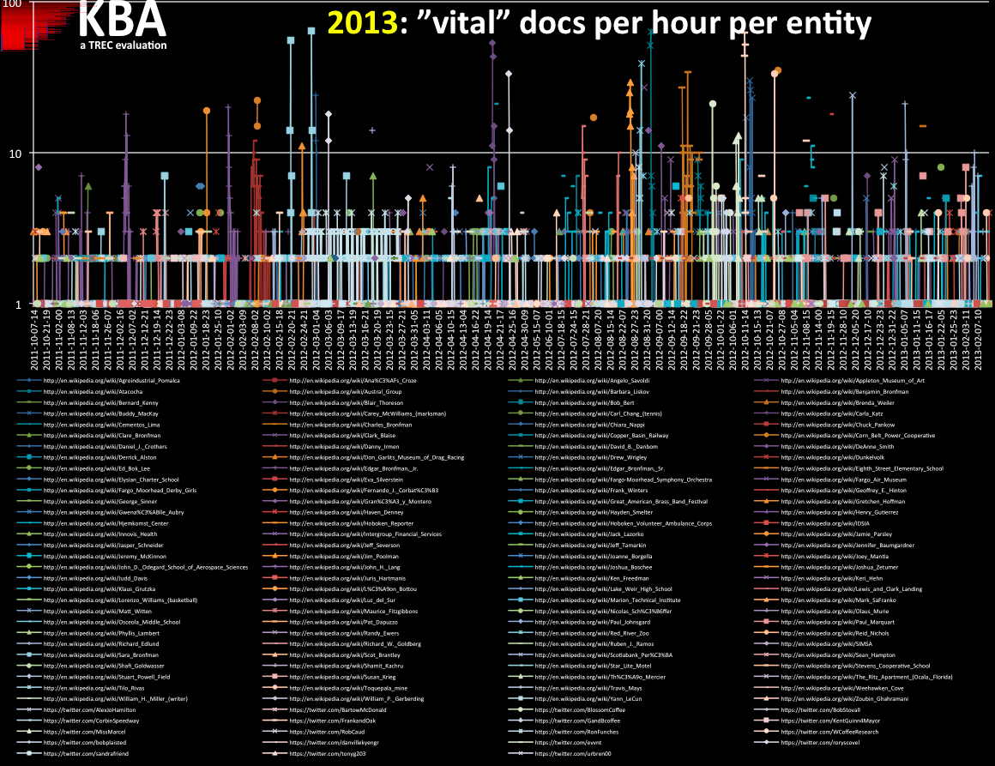

Slide 33
2014

Slide 35
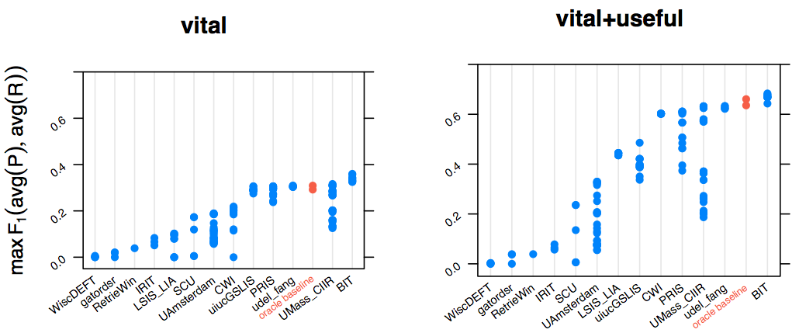
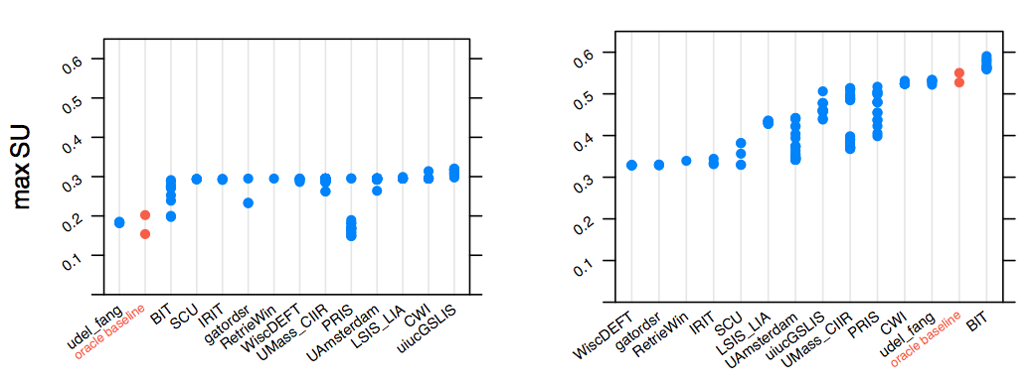
2013

Slide 36
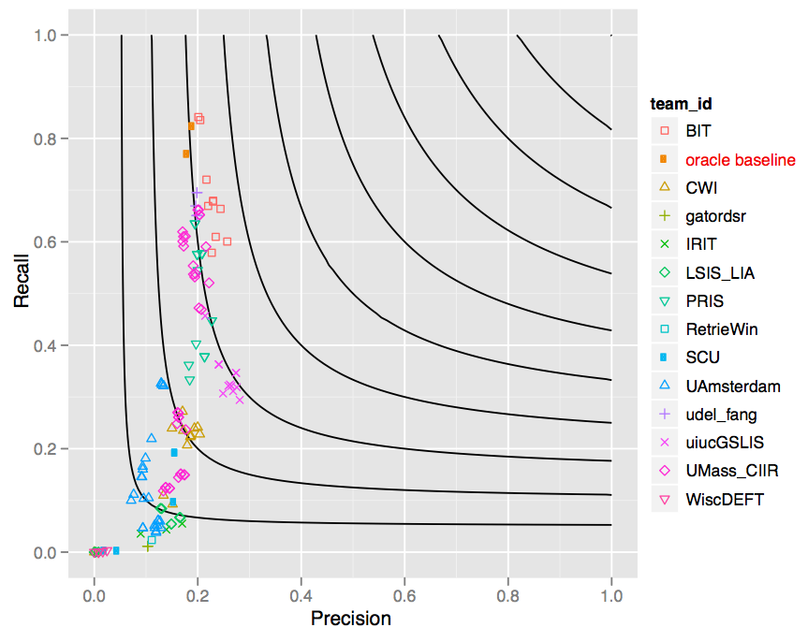
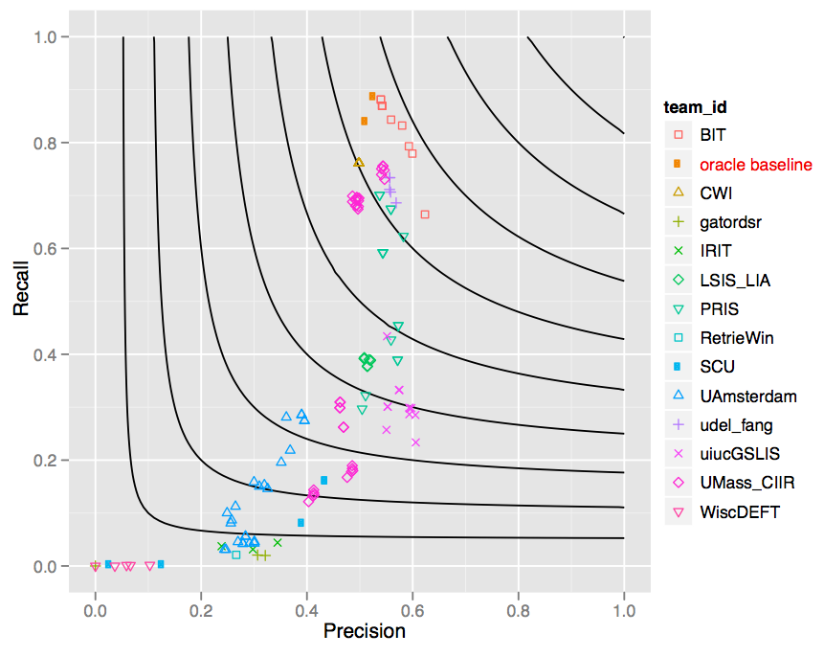
vital-only
vital+useful

Slide 37
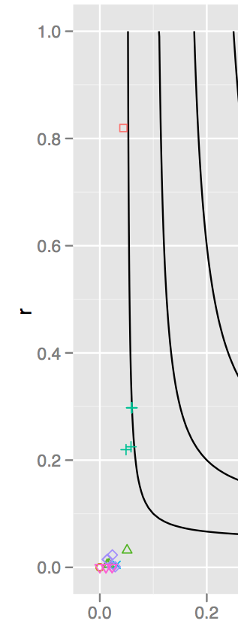
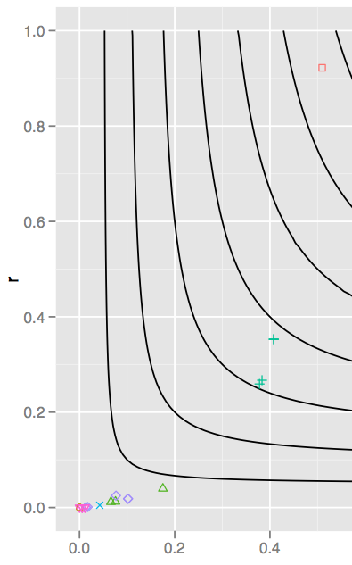
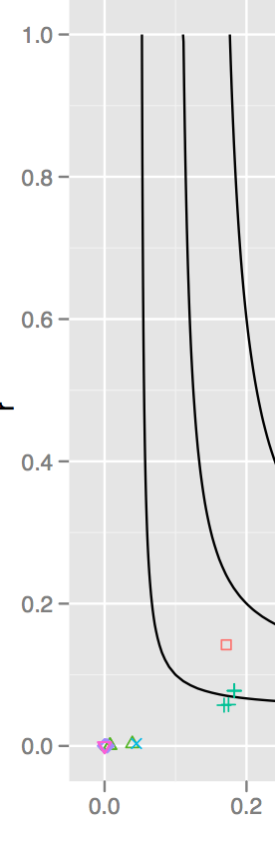
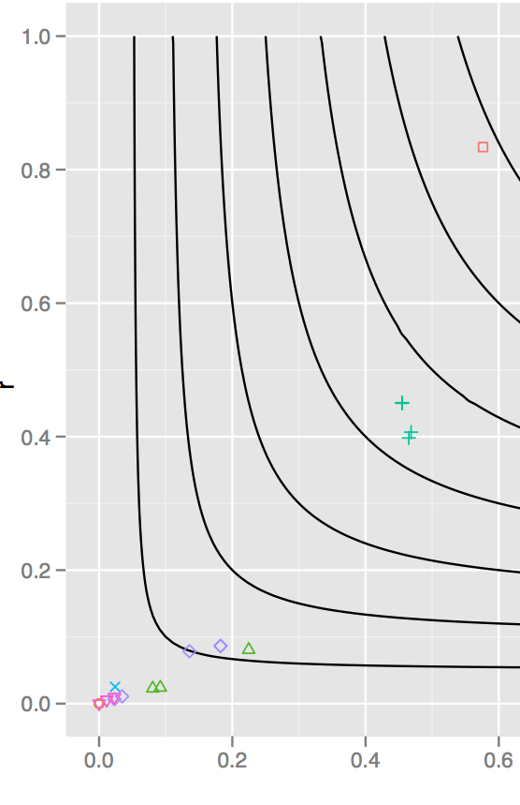
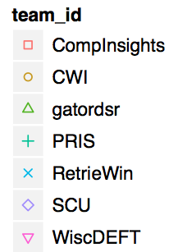
DOCS OVERLAP FILL DATE_HOUR
oracle baseline

Slide 38
training
evaluation
Corpus counts per hour
100,000
10,000
1,000
Pre-hoc assess all surface mentions
100
10
100
“vital” docs change entity profile, usually filling a slot
10

Slide 39
## https://kb.diffeo.com/Jeff_Mangum PER_EMPLOYEE_OR_MEMBER_OF: neutral milk hotel
## https://kb.diffeo.com/Andy_Billig PER_SCHOOLS_ATTENDED: georgetown university

